Slide 1
Sanitary Engineering
Sewerage Engineering
Chemical Characteristics
By
Dr. Muhanad M. Abbas

Slide 3
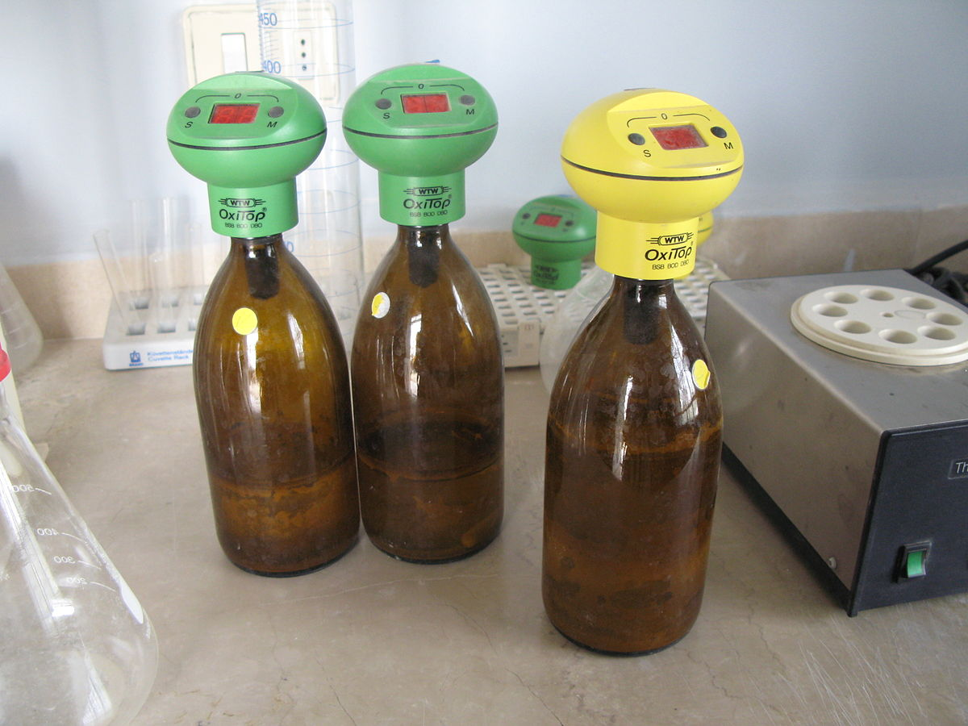
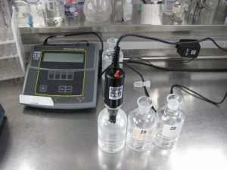

Slide 8
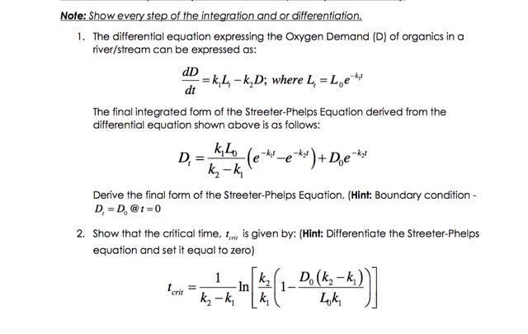

Slide 9
